Slide 1
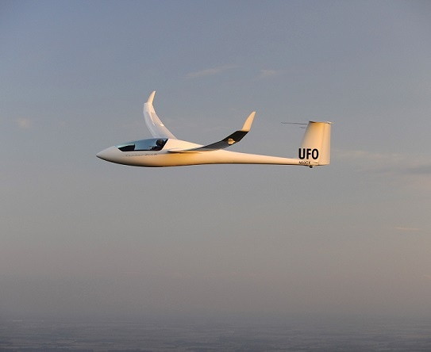
Water Ballast In A Glider
What Is It Good For?

Slide 2
What Kind of Glider?
Water ballast can only safely be added to a glider prepared to carry it.
Location is mostly in the wings, some in the tail
Bladders used to be found in front of spar, now integral tanks
Usage became widely spread with the advent of composite construction
Water has to be dumped before landing
Ballast weight became insanely high in last 20 years, now up to 400+lbs (single seater)
Flapped gliders can carry more ballast weight

Slide 3
Effects of Ballast
Increase in runway length needed
Need powerful tow plane, higher tow speeds
Stall speed of glider is higher
Climb rate on tow is diminished
Climb rate in thermals, circling speed, turn radius
Glider is less maneuverable
Note that these are all negatives!
Higher demands on pilot

Slide 4
Positive Effects of Ballast
All this is only important if you fly X-Country!
Goals for x-country flight:
Cover a maximum amount of distance (limitation is thermal activity)
Cover a given amount of distance in shortest possible time (Speed Task)
Achieve the highest average speed over a certain time interval (OLC speed)
General effects of ballast
Fly at a higher speed with the same glide ratio as un-ballasted
Convert dynamic energy into potential energy more efficiently when entering thermal
Dolphin-style flying on good days, streeting
Have a smoother ride on a bumpy ridge, at higher speeds than un-ballasted

Slide 5
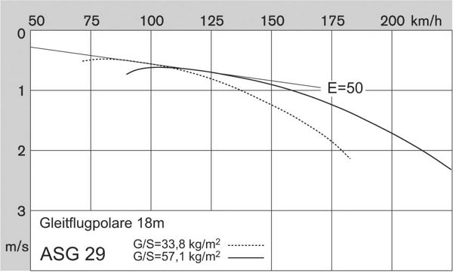
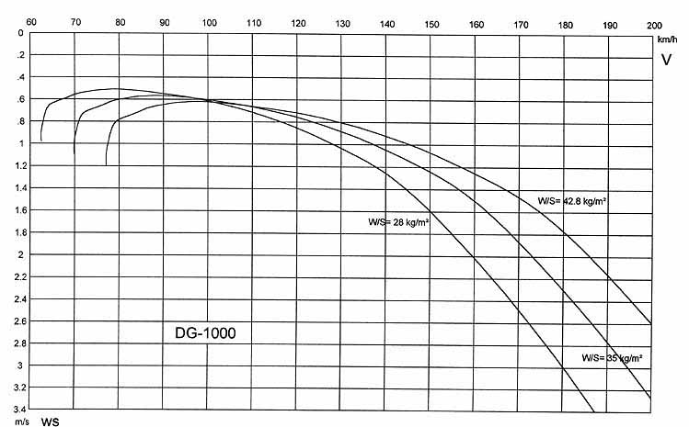
Physics and Graphs
Change of Glider Polar with mass

Slide 6
More physics
Potential Energy = Mass (in Kg or lbs) times Delta H (Height gained in m or feet)
My ASG 29 had an empty mass with pilot of 900 lbs
Max water load was 370 lbs or 40% of empty mass
Potential energy once at cloud base is 40% higher than without water
Visible effect: When running with an unballasted glider at 100 knots for comparison, you magically see the other guy hopelessly sink below you
You arrive higher at next thermal, possibly using a better part of it

Slide 7
Great, why don’t we do that every day?
There’s no Free Lunch
All that weight needs to be lifted up to where it works for you
Coring and centering a thermal
Higher circling speed, larger radius
Climb rate is lower
“I got him on the climb, he got me on the run”
Early and late in the day, conditions may not allow decent climbs
“You got to know …”
You've got to know when to hold 'em Know when to fold 'em Know when to walk away And know when to run
(Kenny Rogers, The Gambler)

Slide 8
How to get started
Very Slowly, work your way up
Try 5 gal (41.6 lbs) in each wing
For Standard Class, be prepared for ‘feeling’ the effect on tow
Tow pilot needs to be aware of ballast
Impact on stall and circling speeds will be minimal
Inter-thermal speeds should be increased
Go up in ballast amount incrementally, note the effects on handling
Cg position will mostly change with ballast, have proper weight and balance done, adjust cg by adding tail water or weight in rear battery box
Dump water while on the ground, note the time it takes
Open dump valves early so that water is gone when at position
Add “dump ballast” to landing check list

Slide 9
Changes to Flight Strategy
Picking only the strongest thermals becomes even more important
You need to be experienced and relaxed in thermal flight optimization
Reading and taking advantage of cloud line-ups becomes even more important
Don’t circle unless you really have to
Leave the thermal when climb rate is down to 70% of strongest value
Being low in weak and broken thermals becomes even more frustrating
When conditions weaken, consider dumping part of your water
You will most likely find a really strong thermal right after doing so
Let your flight computer know how much water you carry, it will adjust speed-to-fly and final glide.
Adjust MC value for the lower climb rates you achieve

